Slide 1



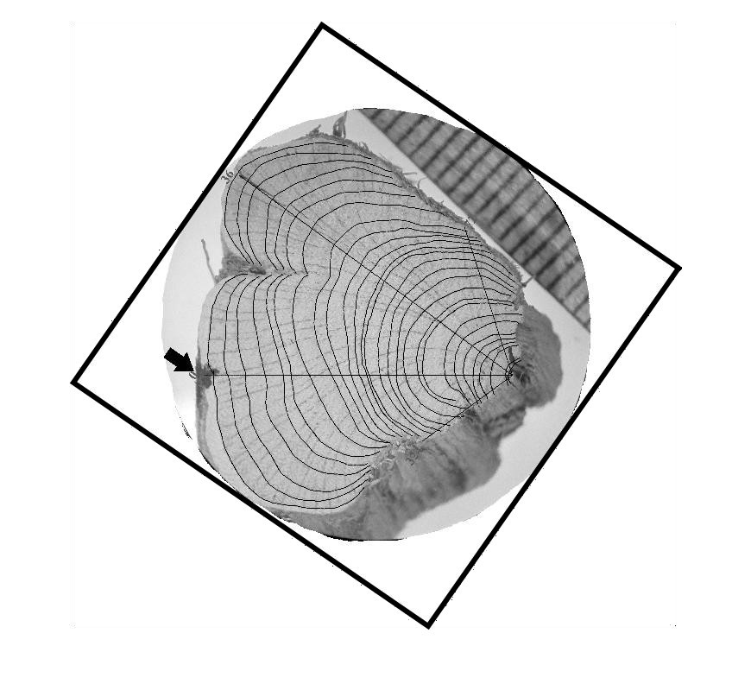
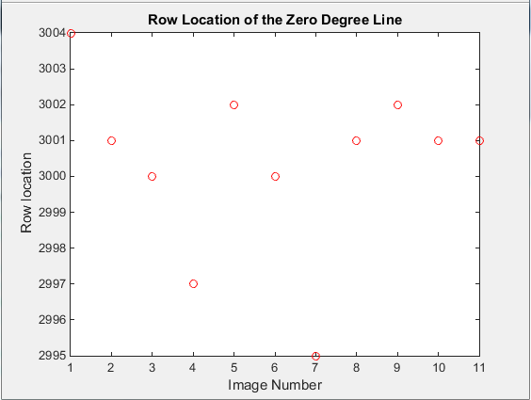
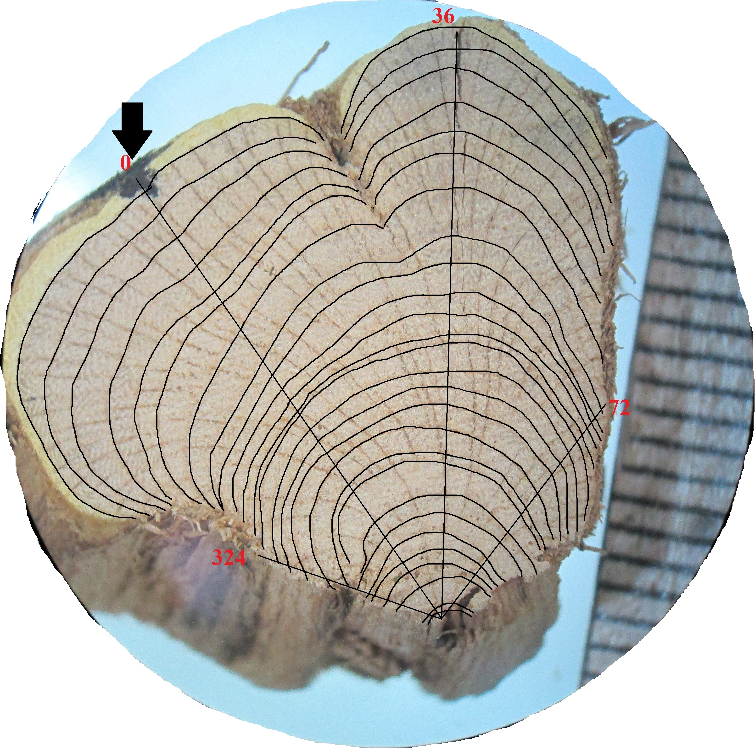
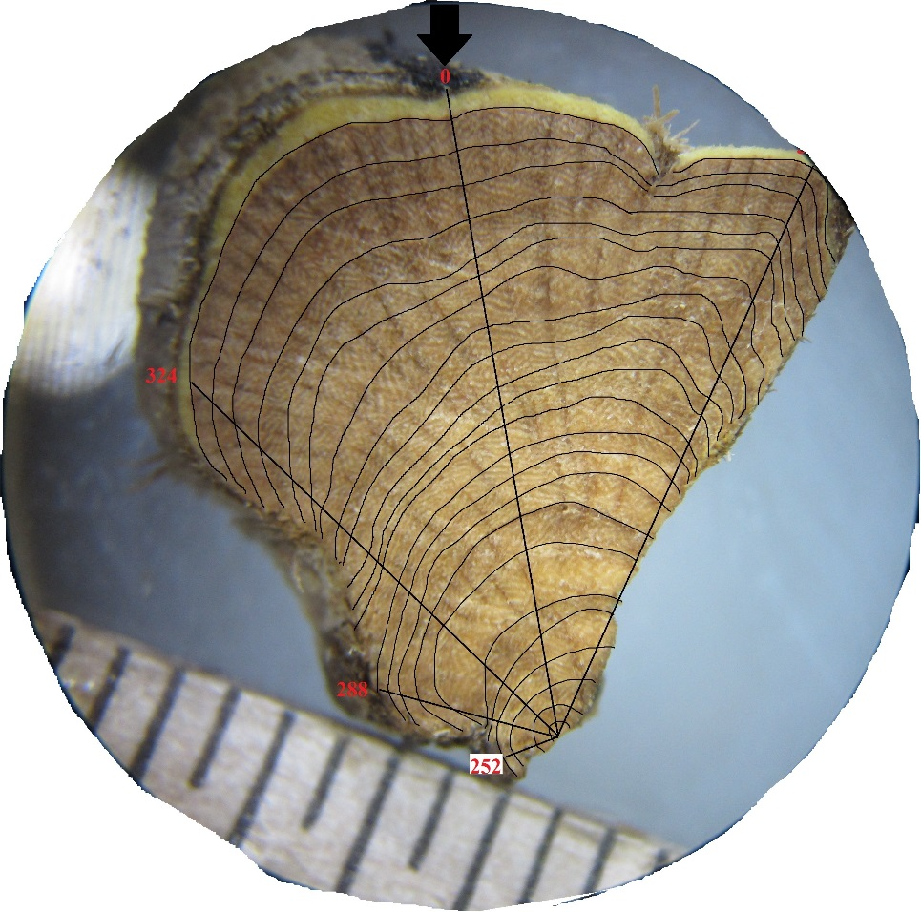

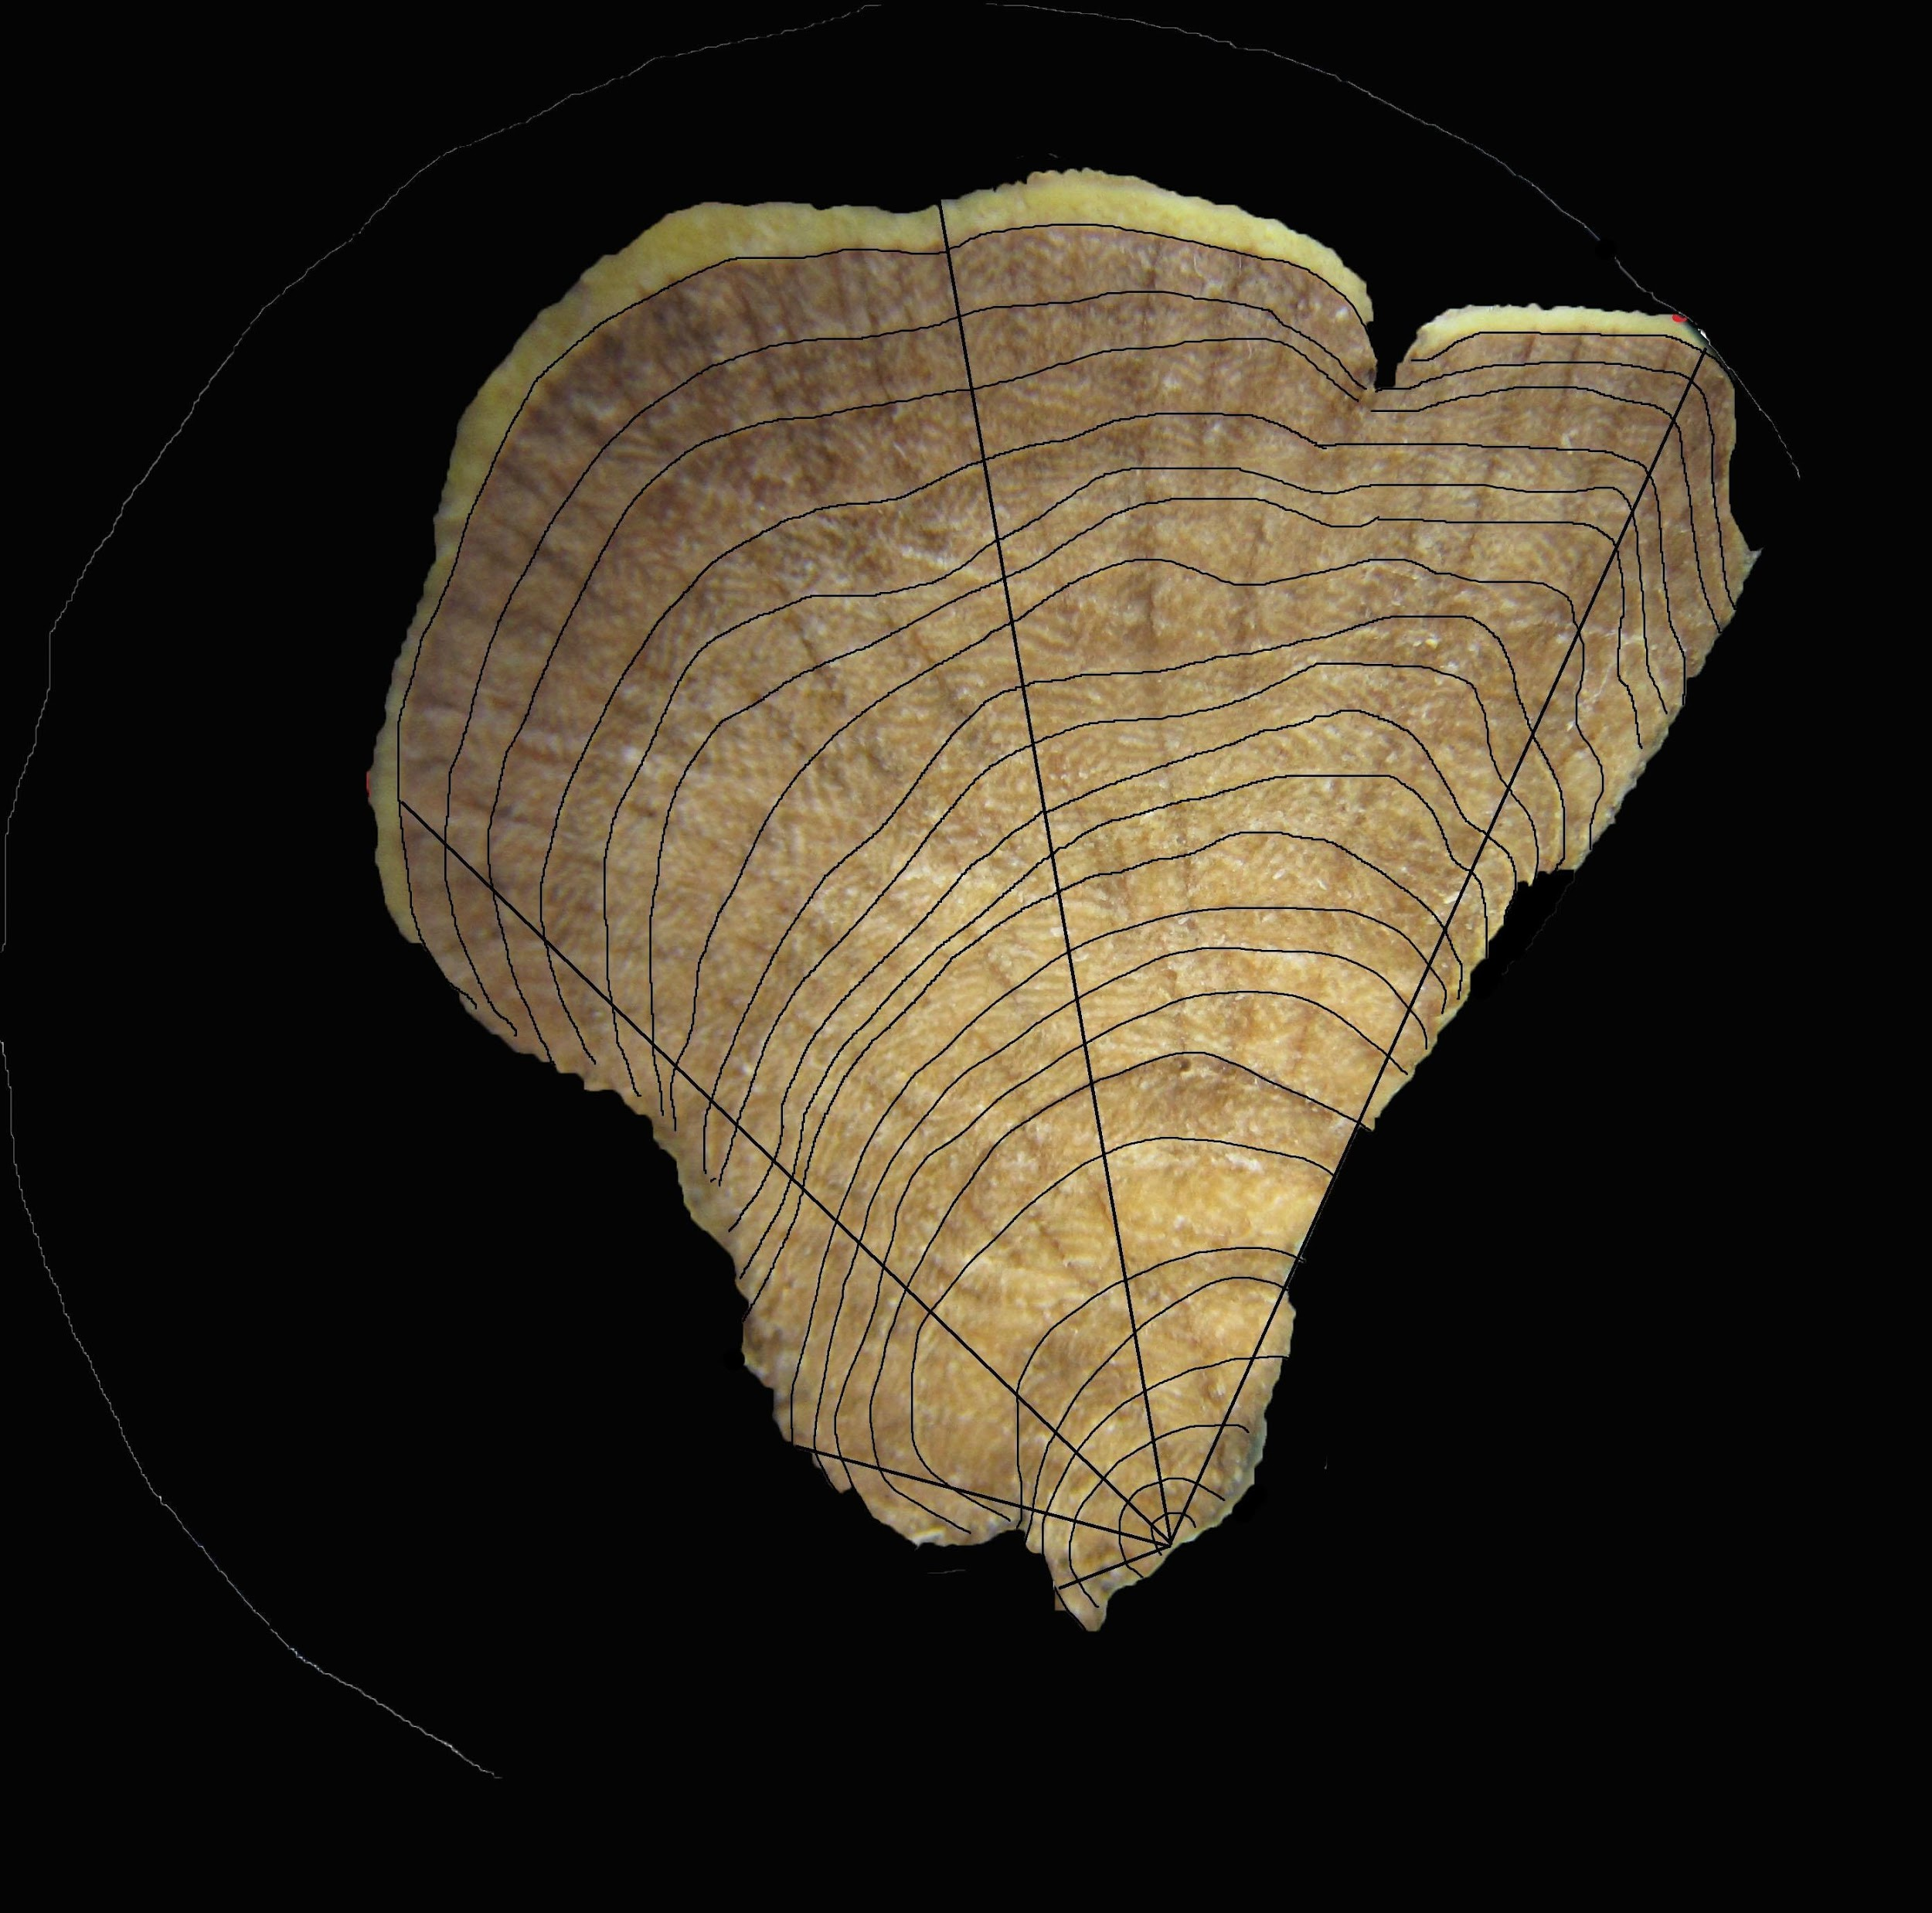

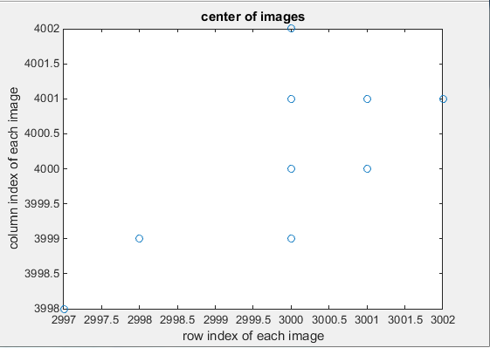
3D Visualization of Growth Pattern of Artemisia tridentata (Sagebrush)
Authors: Michael Scarinci¹, Katherine Encanarcion¹ and Nicholas Italiano¹
Advisors: Dr. Angel R. Pineda¹ and Dr. Lance Evans²
¹Mathematics Department, Manhattan College, Bronx, NY
²Biology Department, Manhattan College, Bronx, NY
Introduction
Image Calibration
Plants of Artemisia tridentata are dominant plants in the American southwest.
Many species of Artemisia tridentata show extensive eccentric growth, which probably limits its ability to grow tall.
The purpose of our study was to create an accurate pictorial 3-D representation of xylary rings of an eccentric stem.
Each xylary ring indicates a year of growth for the plant. Artemisia tridentata are the only known species displaying eccentric growth. It is believed they sacrifice ring growth in order to flower and reproduce.
Images were loaded into MATLAB and then scaled to the same resolution using the imresize function.
The images were then rotated to align the zero angle designated by the black line drawn in sample collection (Fig 2).
A
B
C
Fig 2. A) Sample before image calibration in MATLAB. B) A sample of an image completely calibrated. C) A graph representing the error in rotation of the samples based on the zero angle outlined in sample collection.
A
B
C
Images were then translated to have their biological centers aligned (Fig. 3).
Fig 1. A) The original sample image of one cut of the branch. B) A mask of the original image displaying only the branch, the bark was removed. C) The mask is applied to the original image to show the inner part of the sample.
Sample Collection
Stems were collected near Fremont Canyon, Utah.
They were prepared by Dr. Lance Evans’ lab at Manhattan College.
A vertical line was drawn on each stem in order to reconstruct the stem following cutting. This allowed for orientation to remain the same for different slices.
For each stem, segment sectors were drawn and xylary rings were labeled (Fig 1A).
A
B
Fig 3. A) Zoomed image showing the biological center used for aligning the images. B) A plot of the error in translation of each image.
Notes:
Status of Edits (straight from email!):
To Do Still:
-Edit movies by Friday
-fix discolorations in theme
-final format and composition check
Put the code which was used to generate the images in the poster in that folder (unable)?
Questions that have to be answered:
Did we calibrate the images used for the surface visualization???
Label slide numbers???
Paragraph Spacing???

Slide 2
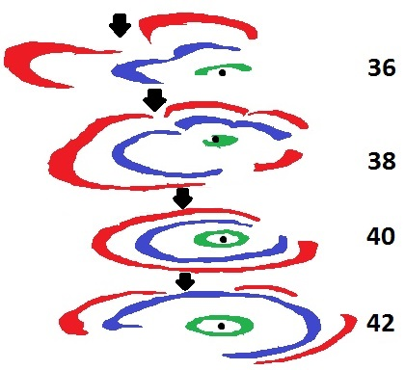
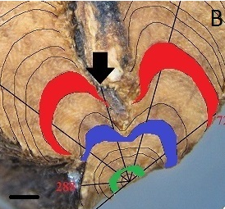
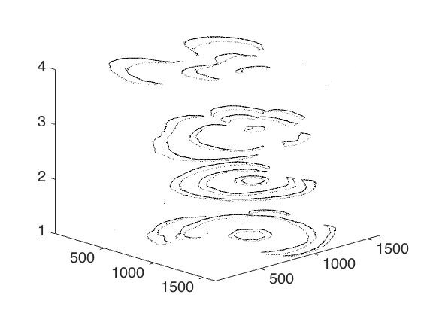
3D Visualization of Growth Pattern of Artemisia tridentata (Sagebrush)
Authors: Michael Scarinci¹, Katherine Encanarcion¹ and Nicholas Italiano¹
Advisors: Dr. Angel R. Pineda¹ and Dr. Lance Evans²
¹Mathematics Department, Manhattan College, Bronx, NY
²Biology Department, Manhattan College, Bronx, NY
Xylary Ring Reconstruction
RESULTS (CLICK TO EDIT)
Xylary Ring 3, 7 and 10 were colored for visualization of the eccentric growth per year.
Fig 6. Final volume visualization of samples 36, 38 40 and 42. The black dot is the biological center and the arrow is the location of the zero angle.
Fig 4. Ring 3, 7 and 10 are colored in green, blue and red respectively.
Ring Visualization
Discussion
With only a few centimeters separating the two samples, there was a significant difference in their ring arcs and area.
Calculating these percentages and areas we are able to identify that ring 10 for Sample 36 was more than twice the area for Sample 42 (Fig 6).
Future Work
An application of this study would be creating a predictive model of xylary ring growth utilizing the location of the complete rings and partial rings, percentages of individual arcs and the ring areas.
Initial work on a full 3D visualization of plants from sample images has yielded promising progress (Fig 7).
Fig 5. Raw volume visualization of samples 36, 38, 40 and 42.

Slide 3
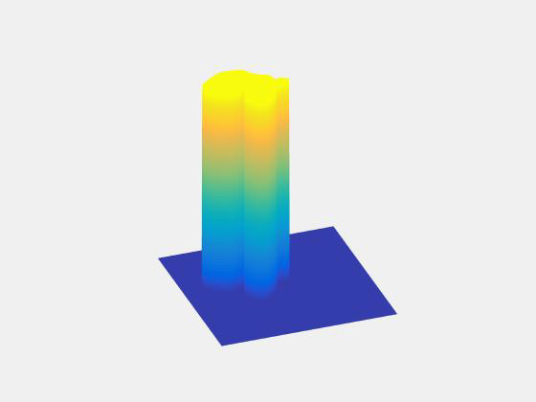
3D Visualization of Growth Pattern of Artemisia tridentata (Sagebrush)
Authors: Michael Scarinci¹, Katherine Encanarcion¹ and Nicholas Italiano¹
Advisors: Dr. Angel R. Pineda¹ and Dr. Lance Evans²
¹Mathematics Department, Manhattan College, Bronx, NY
²Biology Department, Manhattan College, Bronx, NY
Rotating 3D Ring Visualization
Movie 1:. Animation of rings as seen in Figure 8A visualized in MATLAB
Notes:
Caption..
What figure?
Images on the next 2 slides are placeholders for the movies/gifs..

Slide 4
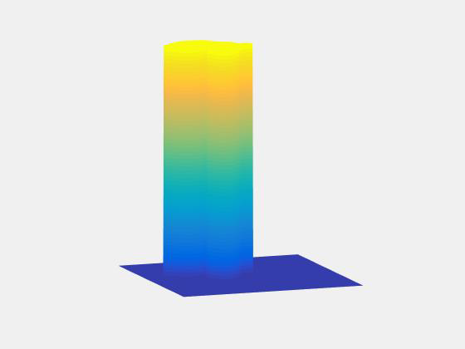
3D Visualization of Growth Pattern of Artemisia tridentata (Sagebrush)
Authors: Michael Scarinci¹, Katherine Encanarcion¹ and Nicholas Italiano¹
Advisors: Dr. Angel R. Pineda¹ and Dr. Lance Evans²
¹Mathematics Department, Manhattan College, Bronx, NY
²Biology Department, Manhattan College, Bronx, NY
Rotating Surface/ Future Work Visualization
Movie 2:. Animation of surface shown in figure 8B as visualized in MATLAB
Notes:
Caption?
Cut avi to show surface only
Change Matlab figure background
Size, shape and lighting
Rotate figure
Increase font

Slide 5
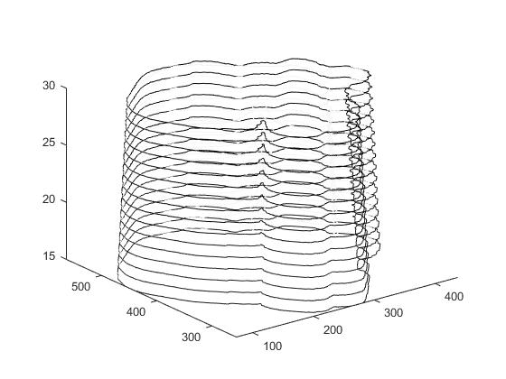
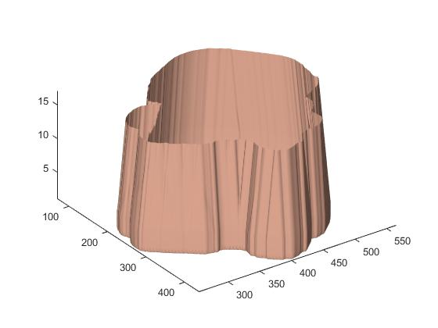
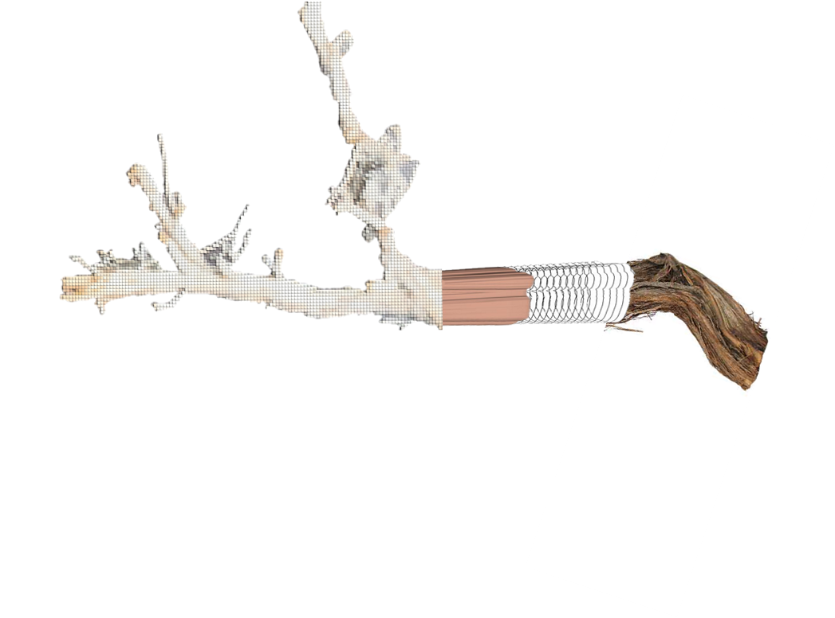
3D Visualization of Growth Pattern of Artemisia tridentata (Sagebrush)
Authors: Michael Scarinci¹, Katherine Encanarcion¹ and Nicholas Italiano¹
Advisors: Dr. Angel R. Pineda¹ and Dr. Lance Evans²
¹Mathematics Department, Manhattan College, Bronx, NY
²Biology Department, Manhattan College, Bronx, NY
A
B
Fig 8. Concept of what a full 3d volume visualization would look like using image processing tools in MATLAB.
Fig 8. A) View of additional volume slices created between sample 42 and 43 B) Visualized surface using additional slices.
Interpolation and morphing methods were used to create additional slices between samples and construct a surface morphed to model eccentric growth (Fig 7).
Acknowledgments
Financial support from the Catherine and Robert Fenton Endowed Chair at Manhattan College.
Student travel support from the Society for Industrial and Applied Mathematics (SIAM).
References
Ardekani, B., S. Guckemus, A. Bachman, M. Hoptman, M. Wojtaszek, J. Nierenberg. 2005. Quantitative comparison of algorithms for inter-subject registration of 3D volumetric brain MRI scans. Journal of Neuroscience Methods 142: 67-76.
Bilbrough, C.J. and J.H. Richards. 1991. Branch architecture of sagebrush and bitterbrush: Use of a branch complex to describe and compare patterns of growth. Can. J. Bot. 69: 1288-1295.
Daubenmire, R. 1970. Steppe vegetation of Washington. Technical Bulletin 62. Washington State Agricultural Station, College of Agriculture. Washington State University. Pullman, WA.
Diettert, R.A. 1938. The morphology of Artemisia tridentata Nutt. Lloydia 1:3-14.
Ferguson, C.W. 1964. Annual rings in big sagebrush. Papers of the Laboratory of Tree-Ring Research No 1. University of Arizona Press. Tucson, AZ.
Notes:
Finalize Poster Edits
Discolorations in background and image backgrounds

